Slide 1

Personal and Health Care Product Review Analysis
Presented By Team Five Guys:
Ruby He, Vanessa Liang, Ruizhi Ma,
Haonan Wang, Minke Wang

Slide 2
Agenda
01
Business Problem Statement
What we are trying to achieve?
Why is it important for business stakeholders?
02
Resolution
How we can resolve the problem using business problem to outcome framework?
03
Data Science Driven Approach
How data science and advanced analytics contribute?
04
Recommendations
Where the road lies ahead?

Slide 3
Nothing is Small in Personal Care
We are a Paas Data Science company dedicated to help your business completely understand customer feedbacks and reviews on your products, which is as important as R&D, Marketing and Sales.
Notes:
It is essential that company sells personal care products have full control and management over every perspective related to their product.

Slide 4

Customers are the No. 1 Priority.
Product feedbacks can help:
Maintain Positive Brand Image
Increase Conversion and Sales
Drive Product Improvement

Slide 5
Business Problem Statement
How can we make good use of countless customer reviews generate useful insights from them?

Slide 6
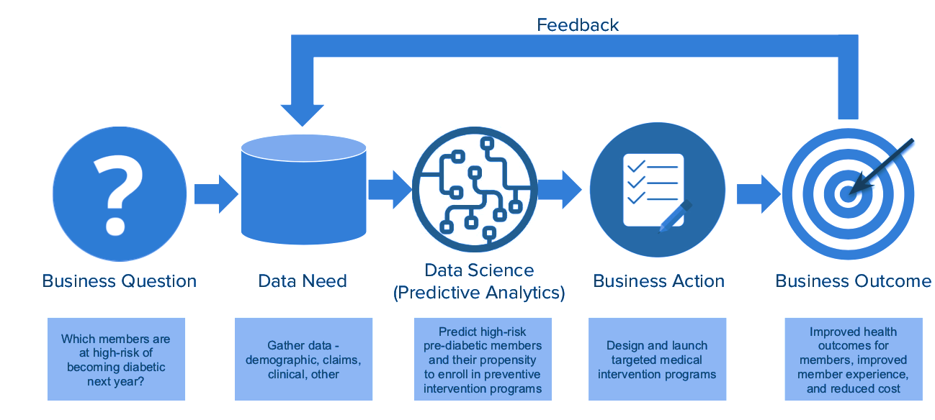
Business Question to Outcome Framework
What is the sentiment of the customer reviews?
Customer Review data, Review rating data.
Predict the negative reviews and customer satisfaction.
Improve product and eliminate customer escalations.
Maintain positive brand image, boost sales and conversion.

Slide 7
Applied Data Science Process Model
Deployment
Business Understanding
Business Understanding
Determine objective, situation, goal and plan.
Data Understanding
Collect, describe, explore and verify data.
Data Preparation
Select, clean, construct, integrate and format data (text vectorization for review data) and ensure reproducibility.
Modeling
Binary classification model(Logit, SVM, RF) to predict review sentiment.
Evaluation
Use classification model metrics to review model result and determine next steps .
Deployment
Plan deployment, monitoring and maintenance of the data science approach.
Evaluation
Data
Understanding
Data
Modeling
Data
Preparation
Source: https://www.the-modeling-agency.com/crisp-dm.pdf

Slide 8

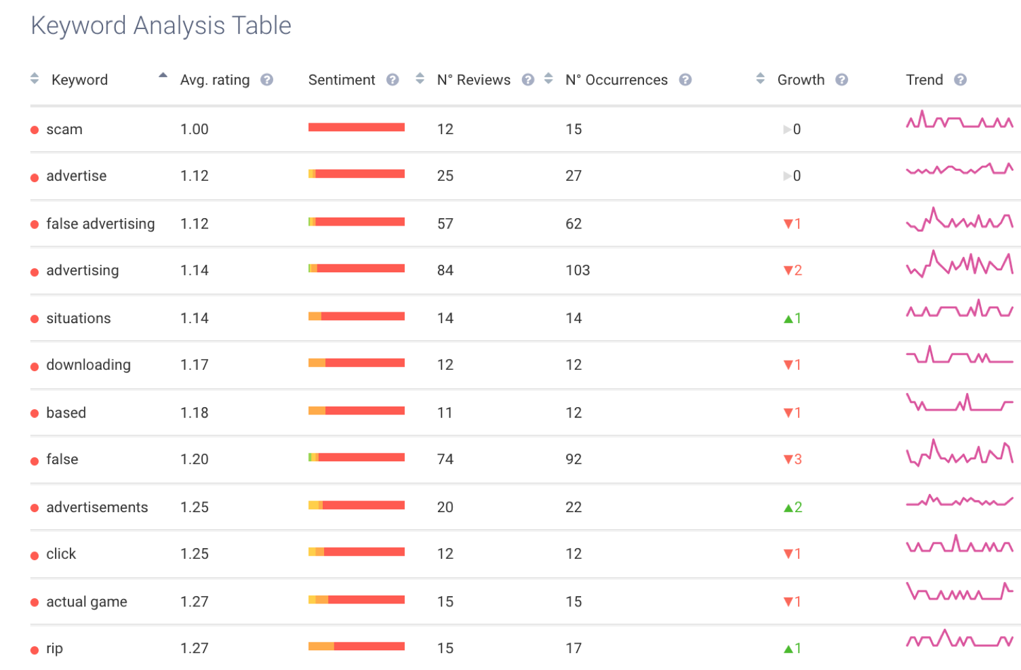


Business Actions
Better Target Customers
Email or call to follow up with unhappy customers
Provide discount to happy customers, encourage them to stay and buy more
Drive Product Improvement
Collect most frequent keywords in negative reviews
Leverage customer feedback to improve product design
Have an Edge Over Competition
Benchmark against competitors
Understand the market trend
Notes:
So what insights our product could provide to the company?
With our product, customer support people can easily segment happy and unhappy customers, and target unsatisfied customers and follow up with them. For marketing people, they can provide coupons, discounts to those happy customers, encourage them to buy more.
Besides sentiment analysis, our product can also help company analyze what are the top keywords in their customers’ reviews, and what are their sentiment scores, the trend of the keywords appearing in different regions, to help the company improve their product features and customize marketing campaigns.
We can also compare the company’s customer satisfaction rate those with the competitors, and provide analysis of the overall market trend. So the company could have an edge over the market competition.

Slide 9

Thanks!
Any questions?
Notes:
So that’s the pitch for our product. Thank you! Does anyone has questions for us?

